Slide 1
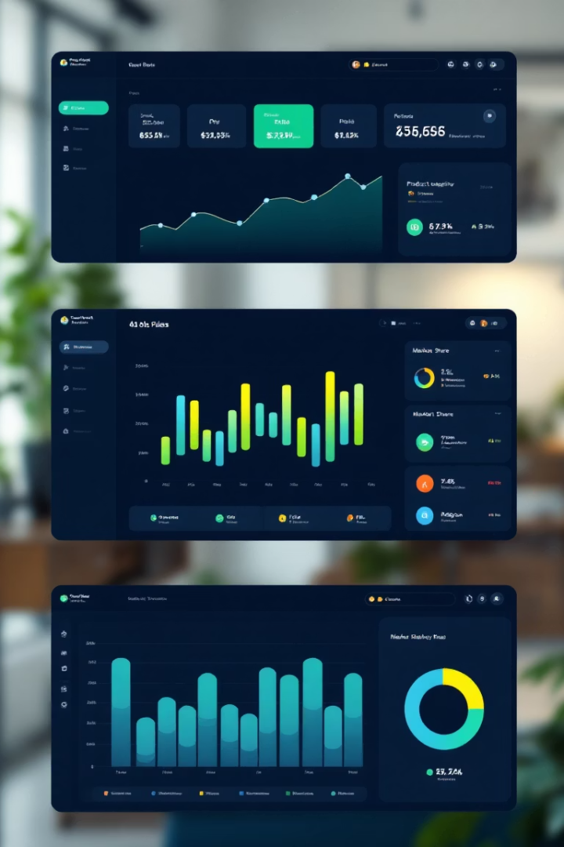

Power BI Dashboard: Sales & Profit Analysis
Interactive report designed for detailed sales and profit insights by category, region, and time period.
by Subir Mondal

Slide 2

Project Objective & Dataset Overview
Dataset Details
Order-level sales and shipping data from task4_1 dataset
Analysis Goals
Understand sales, profit, and growth trends across dimensions
User Interaction
Slicers and filters enable dynamic insights
Dashboard Structure
Supports summary views and detailed category breakdowns

Slide 3

Core KPIs & Metrics
Total Sales
Quick snapshot of revenue generated
Total Profit
Measure of overall business profitability
Real-Time Updates
KPI cards refresh with slicer/filter changes
Visibility
Prominently placed for immediate dashboard insight

Slide 4
Visualizations for In-Depth Analysis
Donut Charts
Bar Charts
Sales by Product Category
Profit by Sub-Category
Sales by Region
Profit by Category

Slide 5




Interactivity & Time Series Analysis
Slicer for Sub-Category
Dynamic drill-down functionality
Time Columns in DAX
Year
Quarter for 2024
Combined Year-Quarter
Time Series Visuals
Track sales and profits trends over time

Slide 6
Theme, Layout & Navigation
Dark Theme
Color Coding
Navigation Menu
User-Friendly Layout
Focus and visual consistency
Clear, consistent formatting across charts
Home
Clean, readable with intuitive interactions
Year View
Quarterly View
Trend Analysis

